Slide 1
Final Project
Course- Information Architecture
(DAV-6100)
Presented By - Group 2

Slide 2


1
Overview
2
About Data
CONTENTS
3
Architecture
Architecture
4
OLAP & OLTP
5
Reporting & Analysis
6
Challenges

Slide 3
Stack Overflow Data Warehouse Solution
Project Overview
Our project is focused around building a data warehouse solution for the Stack Overflow platform
The data warehouse will help Stack Overflow achieve their analytical needs like user interests, membership info, active user info & trending technologies/topics etc.
Stack Overflow can improve their advertising and marketing revenue model by analyzing these users activities, interest and engagement metrics
This can also help Stack Overflow with providing better job recommendations to end users who are actively looking for change. This improved jobs listing model can help them to increase ad revenue
The data warehouse will provide a more comprehensive view of Stack Overflow and will provide data which will (in theory) be used to improve site performance

Slide 4
Roles and Responsibilities
Surbhi - AWS Architect:
Project lead and system architect.
Nosson - Data Enginner:
Collect relevant data according to the needs of the system and users.
Yihang - Database Administrator:
Operate, maintain and manage database management systems.
Yifeng - Database developer:
Design and develop database management systems.
Qianwen - Data Analyst:
Analyze and visualize data, and make industry assessments and forecasts based on data.

Slide 5
1
1
Overview
Overview
2
2
5
Architecture
About Data
CONTENTS
3
3
Architecture
About Data
Architecture
4
4
SQL
OLAP & OLTP
5
5
Reporting & Analysis
Reporting & Analysis
6
6
Challenges
Challenges

Slide 6

About Data
Stack Overflow - Stack Overflow is a question and answer website for professional and enthusiast programmers. It features wide range of topics in the world of computer programming. They also provide membership options along with job portal features for their customers.
Data Source - https://relational.fit.cvut.cz/dataset/Stats
We are acquiring datasets from RELATIONAL DATASET REPOSITORY (An anonymized dump of all user-contributed content on the Stats Stack Overflow network)

Slide 7
Summary of Datasets
Entities in Data Warehouse-
Posts
Comments
Tags
Users
Posts History
Post Links
Votes
Badges
Method of access-
For extracting data from the internet open source we are using mysql connector in python environment and loading all the relevant data into the AWS S3 bucket for storage/Staging.
Data Quality-
There are some missing values in the datasets which will deal according to the requirement.
Basic Exploratory analysis (EDA) is being performed in python environment.

Slide 8
Data Profile
Dataset 1 Summary
Source of information | https://relational.fit.cvut.cz/dataset/Stats
Number of Table | 8
Number of Records | 1,027,838 Rows 71 Columns
Data type and structure | Numeric, String, Temporal
Data Acquitsiton Method | MySQL connector
Dataset 2 Summary
Source of information | https://content.techgig.com/technology/24-highest-paying-programming-languages-for-developers/articleshow/76243434.cms
Number of Table | 1
Number of Records | 24 Rows
Data type and structure | Numeric, String
Data Acquitsiton Method | Web Scraping using python

Slide 9
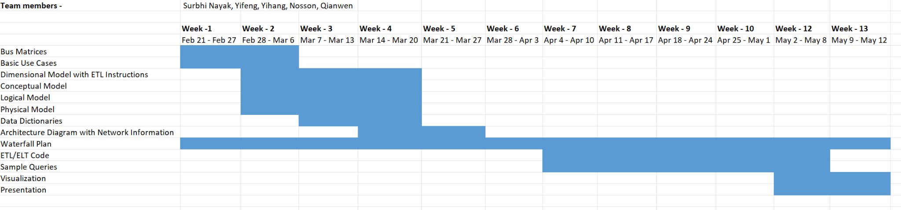
Timeline of the Project
Waterfall Model

Slide 10
1
1
1
1
1
Overview
Overview
Overview
Overview
Overview
2
2
2
2
2
5
5
5
Architecture
Architecture
Architecture
About Data
About Data
CONTENTS
3
3
3
3
3
Architecture
Architecture
About Data
About Data
About Data
Architecture
Architecture
4
4
4
4
4
Reporting & Analysis
SQL
SQL
OLAP & OLTP
SQL
5
5
5
5
5
Reporting & Analysis
Reporting & Analysis
Reporting & Analysis
Reporting & Analysis
SQL
6
6
6
6
6
Challenges
Challenges
Challenges
Challenges
Challenges

Slide 11
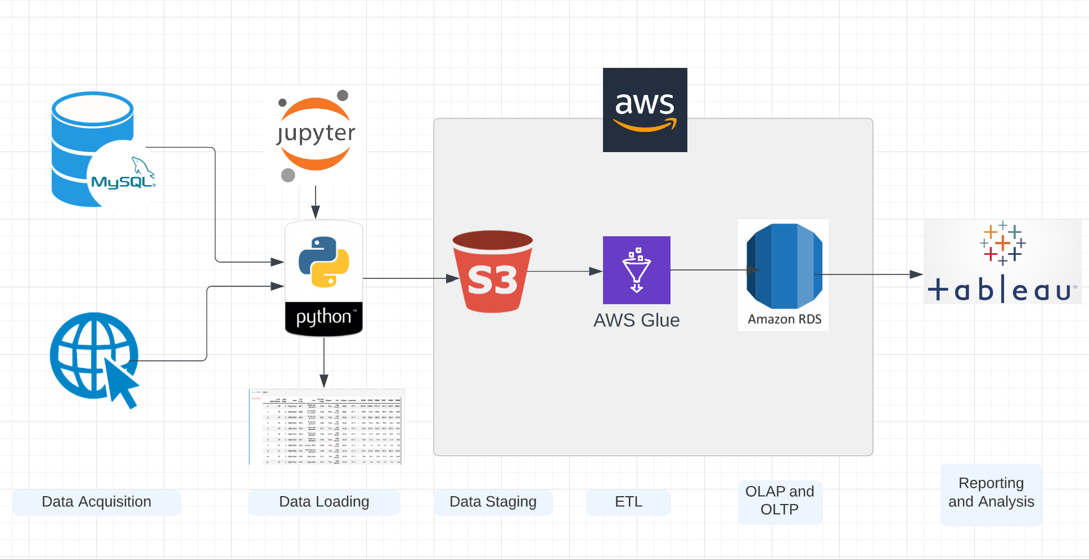
Work Flow

Slide 12
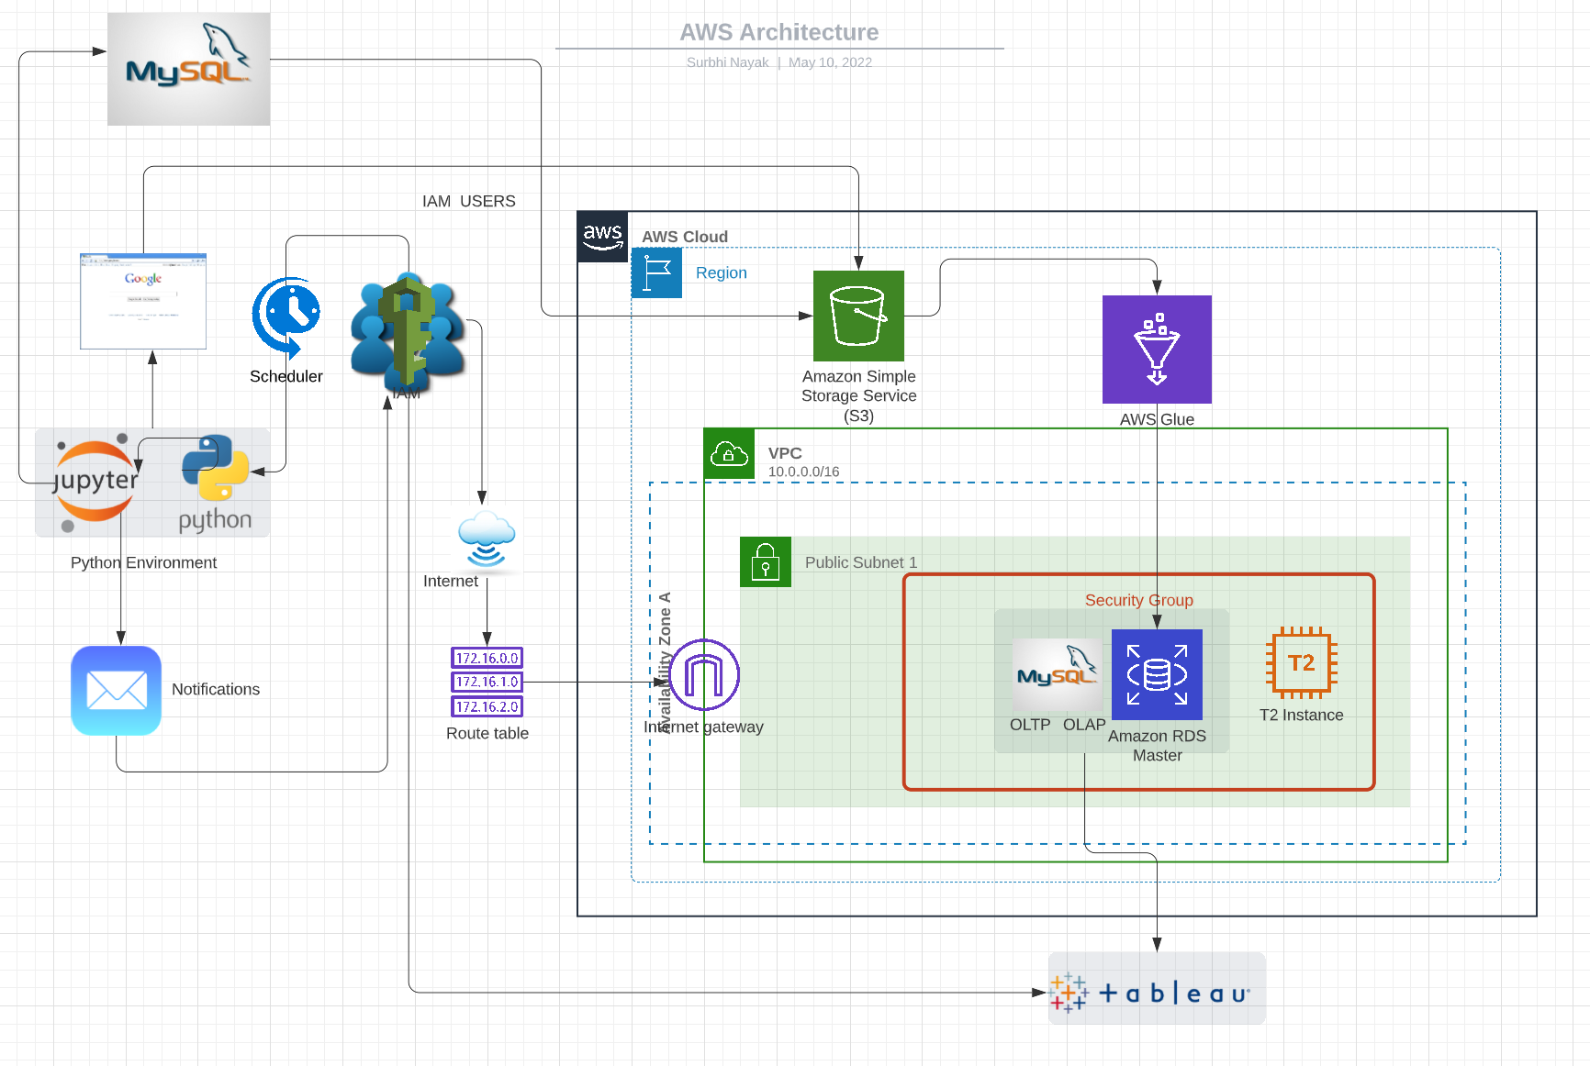
AWS Architecture

Slide 13
1
1
1
1
1
1
Overview
Overview
Overview
Overview
Overview
Overview
2
2
2
2
2
2
5
5
5
5
Architecture
Architecture
Architecture
Architecture
About Data
About Data
CONTENTS
3
3
3
3
3
3
Architecture
Architecture
About Data
About Data
About Data
About Data
Architecture
Architecture
4
4
4
4
4
4
Reporting & Analysis
Reporting & Analysis
SQL
SQL
OLAP & OLTP
SQL
5
5
5
5
5
5
Reporting & Analysis
Reporting & Analysis
Reporting & Analysis
Reporting & Analysis
SQL
SQL
6
6
6
6
6
6
Challenges
Challenges
Challenges
Challenges
Challenges
Challenges

Slide 14
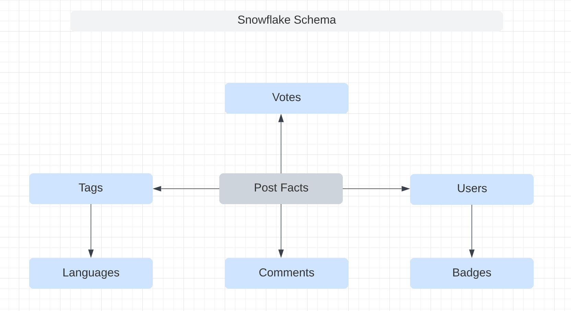
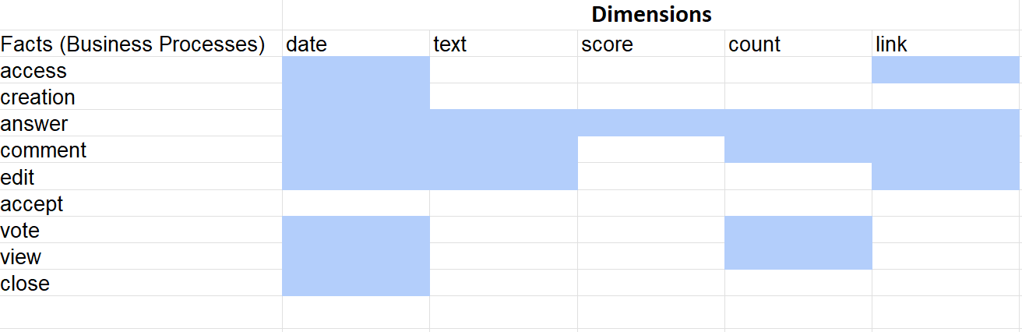
Conceptual Model
Bus Matrix

Slide 15
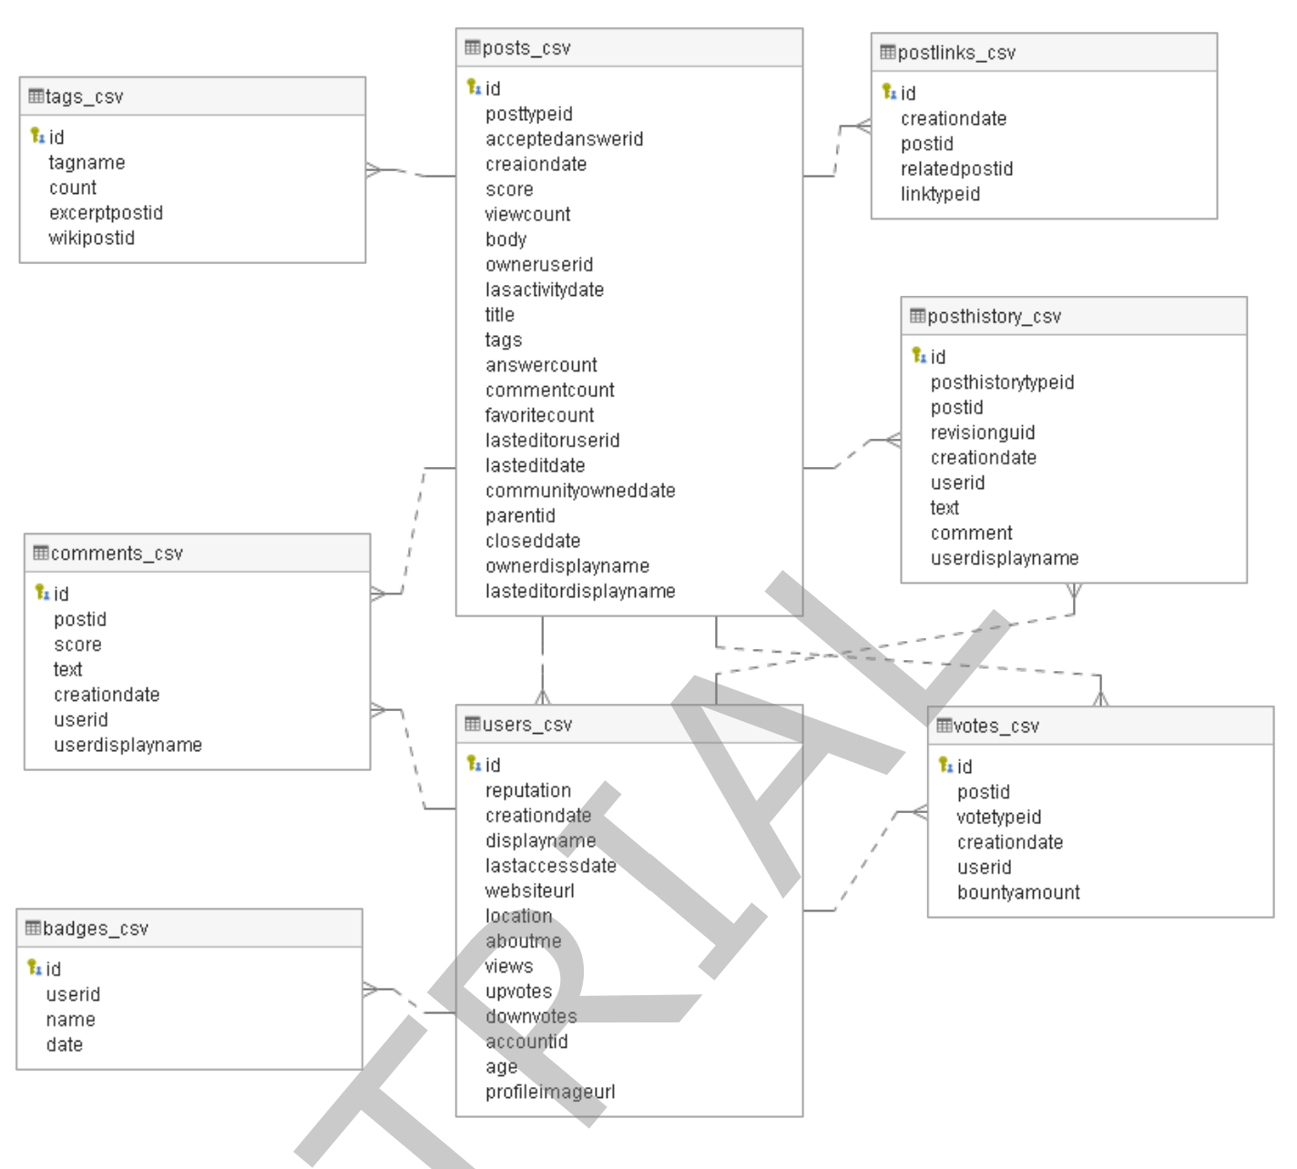
OLTP ERD

Slide 16
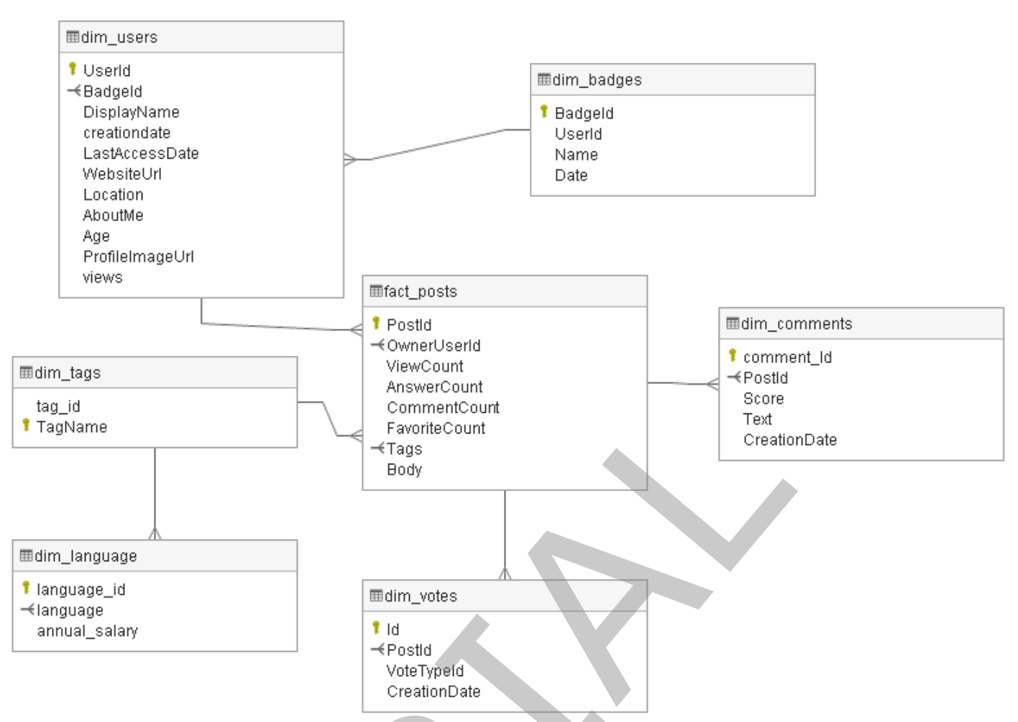
OLAP ERD

Slide 17
1
1
1
1
1
Overview
Overview
Overview
Overview
Overview
2
2
2
2
2
5
5
5
Architecture
Architecture
Architecture
About Data
About Data
CONTENTS
3
3
3
3
3
Architecture
Architecture
About Data
About Data
About Data
Architecture
Architecture
4
4
4
4
4
Reporting & Analysis
SQL
SQL
OLAP & OLTP
SQL
5
5
5
5
5
Reporting & Analysis
Reporting & Analysis
Reporting & Analysis
Reporting & Analysis
SQL
6
6
6
6
6
Challenges
Challenges
Challenges
Challenges
Challenges

Slide 18

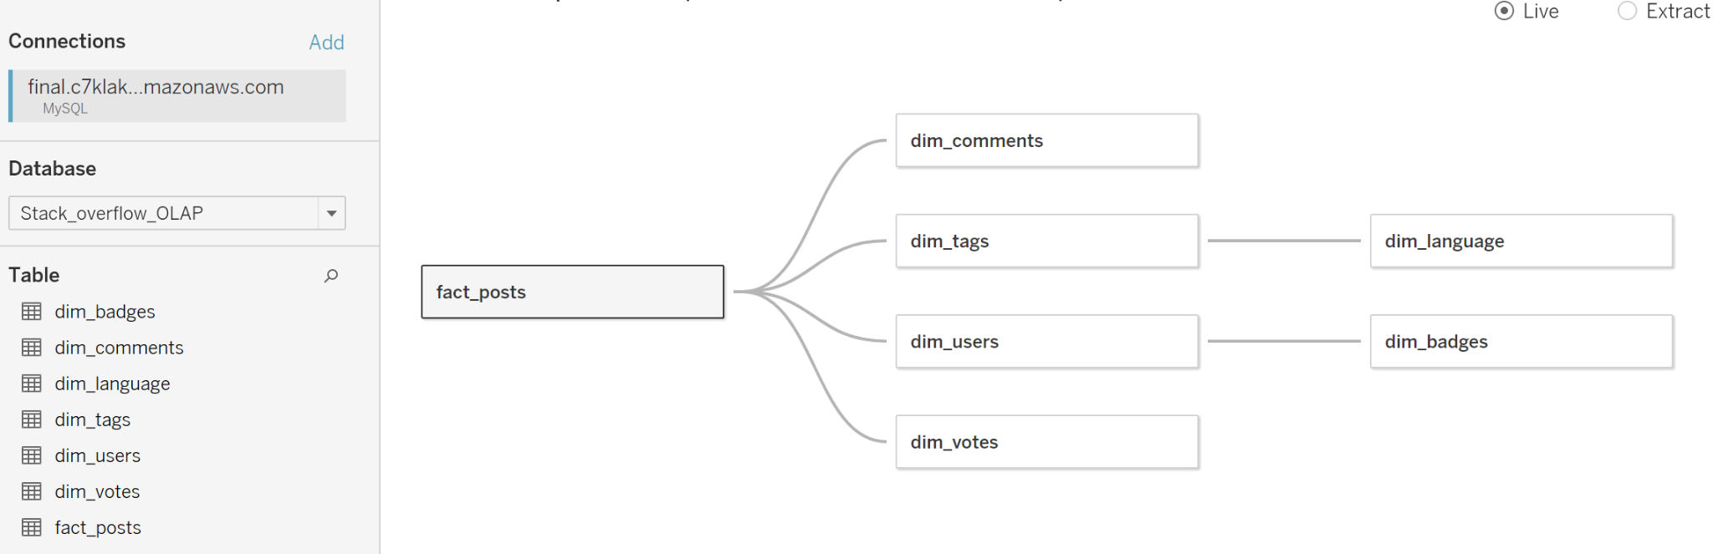
Connection in Tableau

Slide 19
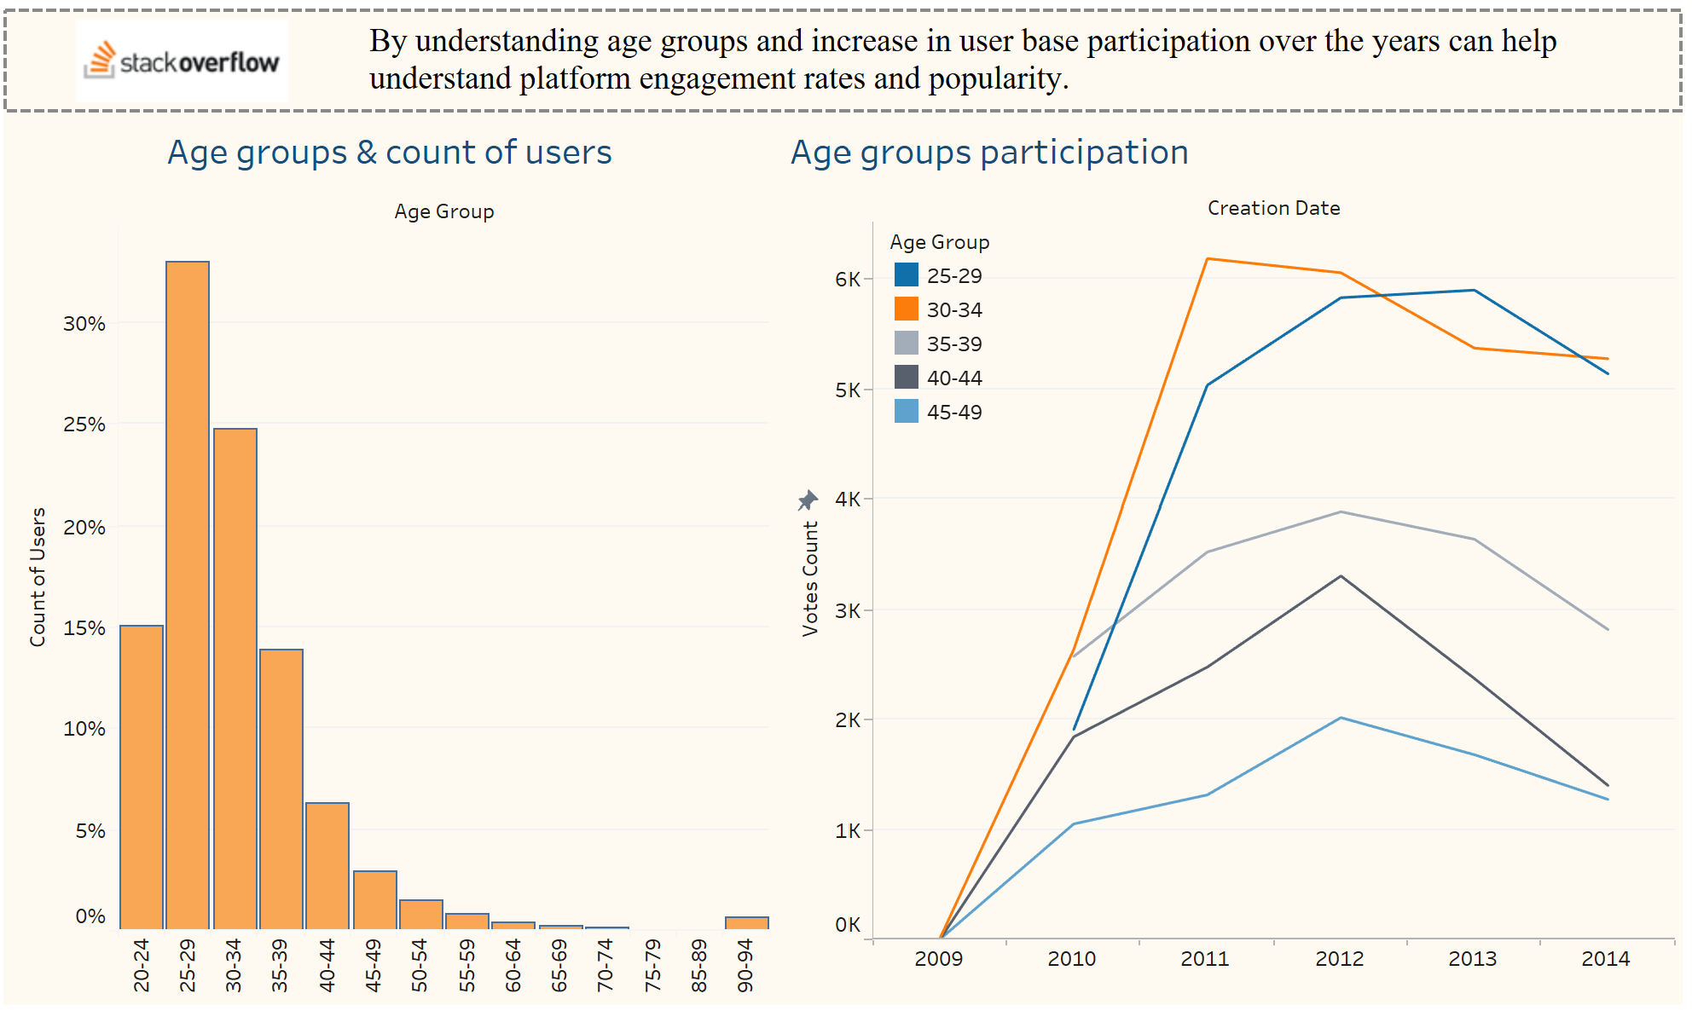

Slide 20
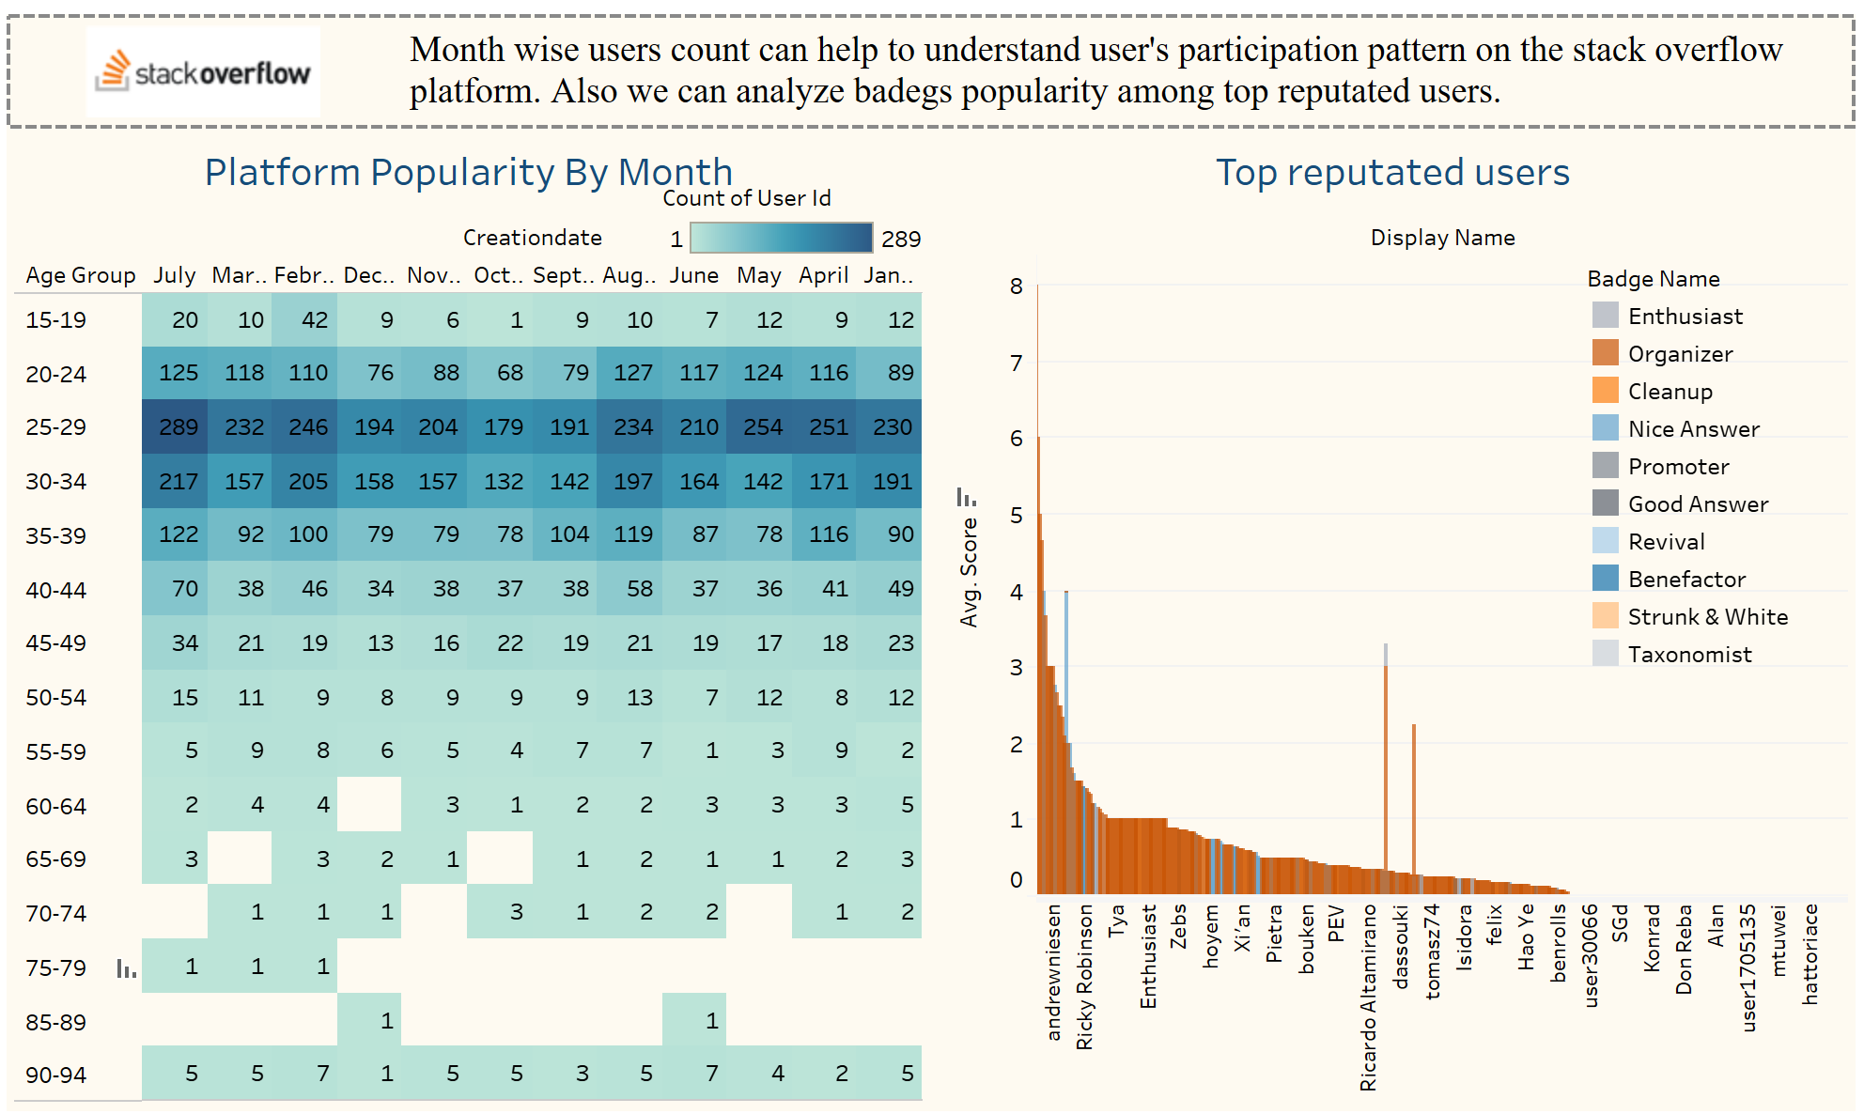

Slide 21
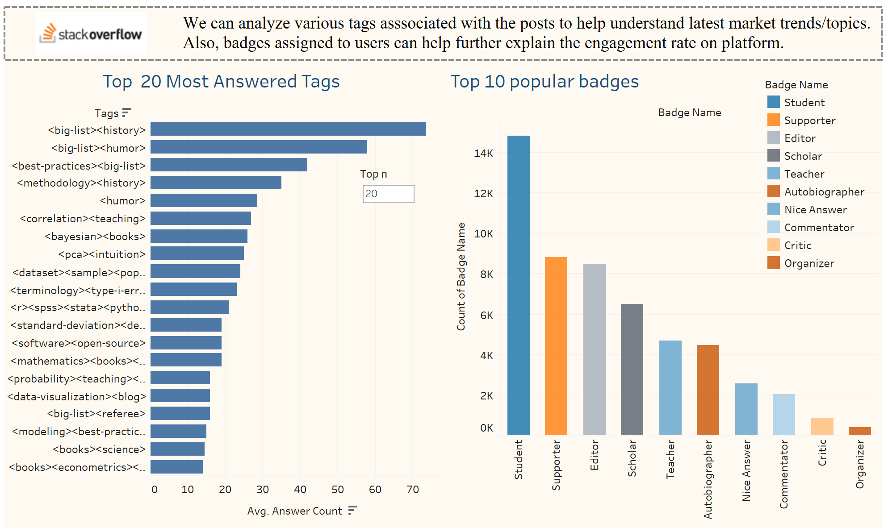

Slide 22
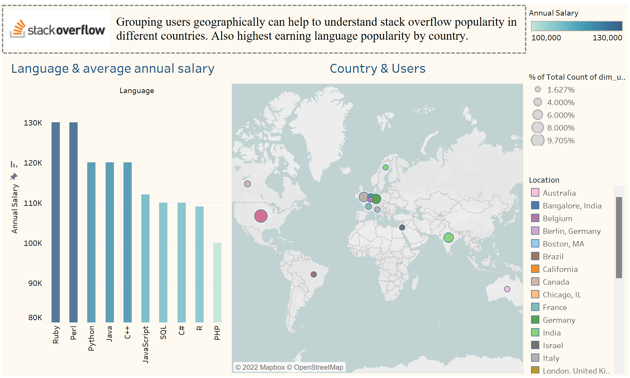

Slide 23
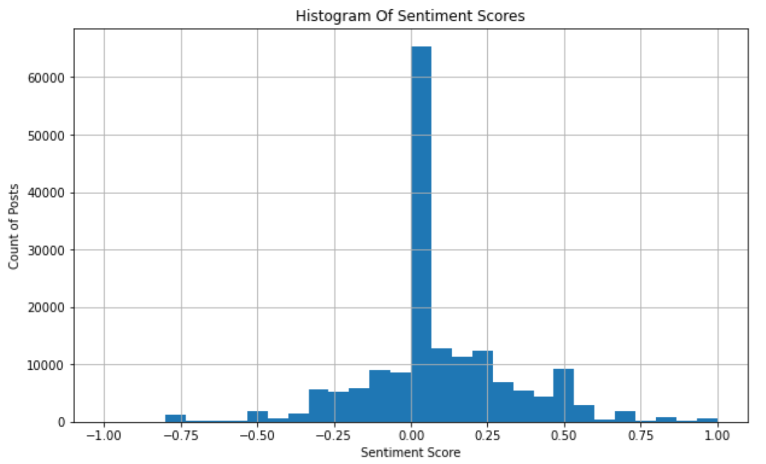
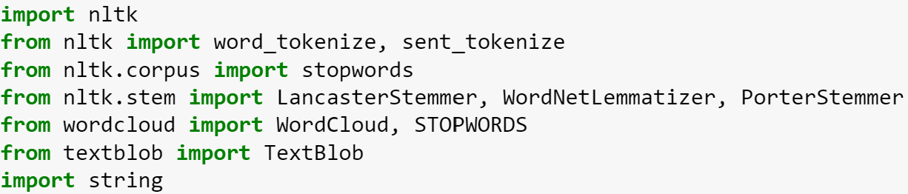
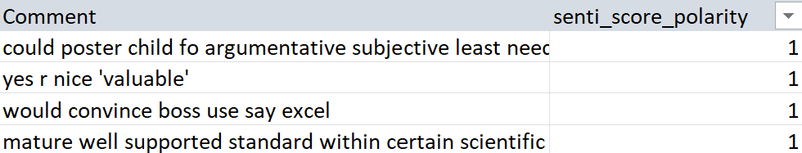
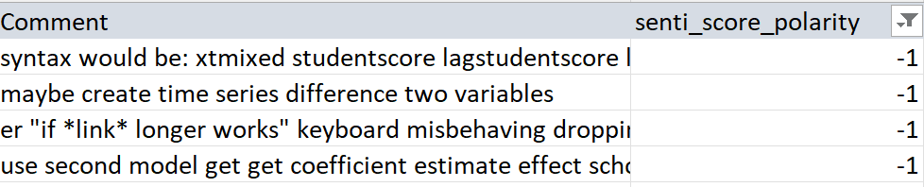

Slide 24
1
1
1
1
Overview
Overview
Overview
Overview
2
2
2
2
5
5
Architecture
Architecture
About Data
About Data
CONTENTS
3
3
3
3
Architecture
Architecture
About Data
About Data
Architecture
Architecture
4
4
4
4
SQL
SQL
OLAP & OLTP
SQL
5
5
5
5
Reporting & Analysis
Reporting & Analysis
Reporting & Analysis
Reporting & Analysis
6
6
6
6
Challenges
Challenges
Challenges
Challenges

Slide 25
Challenges
01
Creating timeline for project
02
Task allocation among the team
03
Finding the data sources and acquisition methods

Slide 26
Thank You!
Any Questions ?

